Slide 1




Slide 2
MIS

Slide 3



MIS
MIS
Facebook Like Raffle Promo

Slide 4
Facebook LIKE Raffle Promo
How can a customer participate on the promo?
For MP/MC division, customers with receipt transaction can participate on the promo.
For The Monarch Hotel / Los Pedritos, customers with receipt transaction can participate.
For AutoGroup, with receipt transactions or branch visit or inquiry can participate.
Notes:
Guanzon Group will have a raffle promo wherein clients that transacts to us will earn raffle entries when they LIKED our Facebook page. All transaction with receipts/invoices will have a webpage link and will be sent to the customer’s mobile number. An auto encoder will be installed to the branch’s PCs to auto send the transaction info to our main server, the branch/client shall only wait 1-5 minutes to receive the promo link.

Slide 5
Facebook LIKE Raffle Promo
Facebook Like Raffle Promo Process
Sales, monthly payment, job order, etc. must be encoded on the system.
Receipts/invoices must be printed/posted.
Notes:
Guanzon Group will have a raffle promo wherein clients that transacts to us will earn raffle entries when they LIKED our Facebook page. All transaction with receipts/invoices will have a webpage link and will be sent to the customer’s mobile number. An auto encoder will be installed to the branch’s PCs to auto send the transaction info to our main server, the branch/client shall only wait 1-5 minutes to receive the promo link.

Slide 6
Facebook LIKE Raffle Promo
Facebook Like Raffle Promo Process
A utility will capture the encoded transaction automatically. (Configured by MIS)
On database/system failure, the branch can opt to manually encode the transaction info
to be sent on the server and process the customer’s raffle entry for his transaction.
Auto Capture Utility
Manual Encoding
Notes:
Guanzon Group will have a raffle promo wherein clients that transacts to us will earn raffle entries when they LIKED our Facebook page. All transaction with receipts/invoices will have a webpage link and will be sent to the customer’s mobile number. An auto encoder will be installed to the branch’s PCs to auto send the transaction info to our main server, the branch/client shall only wait 1-5 minutes to receive the promo link.

Slide 7
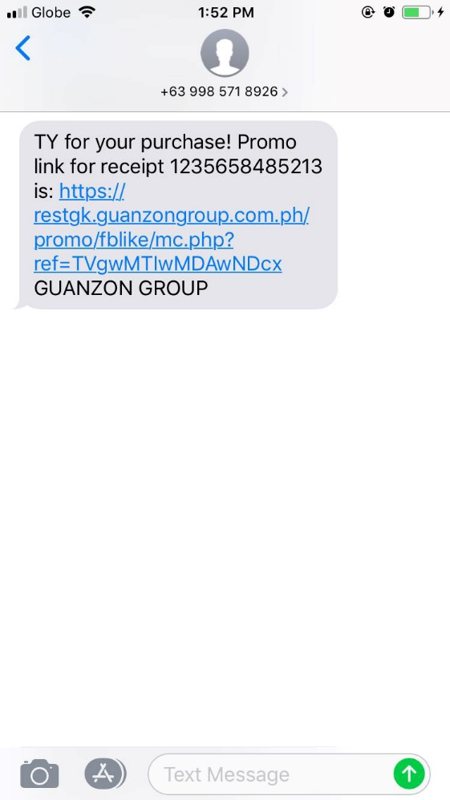

Facebook LIKE Raffle Promo
Facebook Like Raffle Promo Process
When the transaction info saved on the server, a message containing the raffle link with the
document number will be sent to the customer via SMS.
Notes:
Guanzon Group will have a raffle promo wherein clients that transacts to us will earn raffle entries when they LIKED our Facebook page. All transaction with receipts/invoices will have a webpage link and will be sent to the customer’s mobile number. An auto encoder will be installed to the branch’s PCs to auto send the transaction info to our main server, the branch/client shall only wait 1-5 minutes to receive the promo link.

Slide 8
Facebook LIKE Raffle Promo
Facebook Like Raffle Promo Process
When the customer clicks the link, he will be redirected to the promo page.
If he is logged on his phone’s browse he will get in directly to the main page.
If not, he will have to login his facebook account.
Please note that every division has different main page designs.
Notes:
Guanzon Group will have a raffle promo wherein clients that transacts to us will earn raffle entries when they LIKED our Facebook page. All transaction with receipts/invoices will have a webpage link and will be sent to the customer’s mobile number. An auto encoder will be installed to the branch’s PCs to auto send the transaction info to our main server, the branch/client shall only wait 1-5 minutes to receive the promo link.

Slide 9
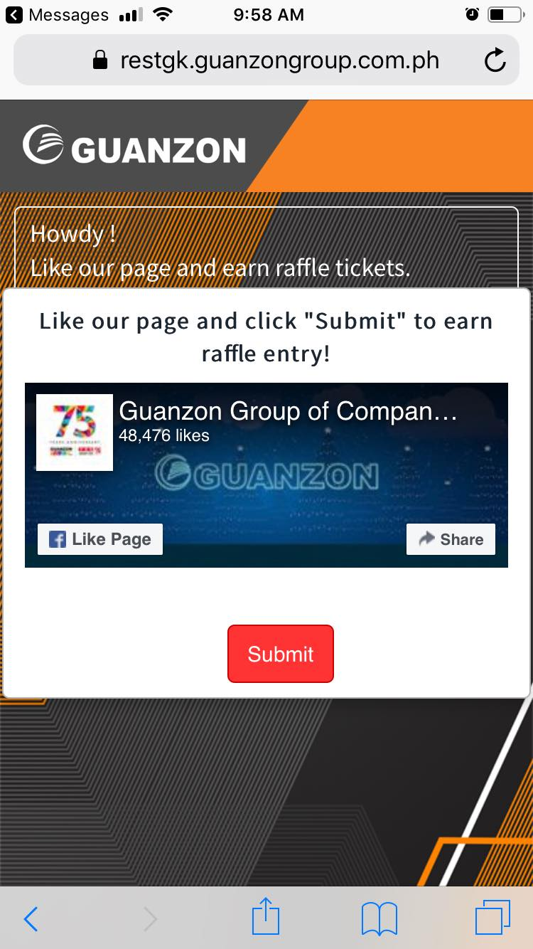
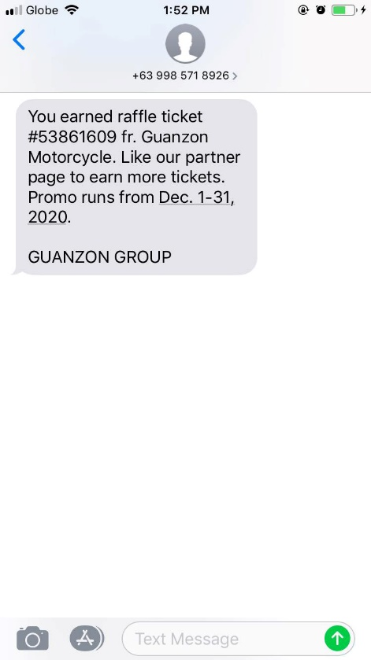
Facebook LIKE Raffle Promo
Facebook Like Raffle Promo Process
When customer clicks the button for the company. The “Company Cover Photo” will appear.
If the page is not yet LIKED, the user must click “Like Page”.
If it was already LIKED, just click the “Submit” button to earn a raffle ticket.
SMS confirmation will be sent to the customer containing the raffle ticket number.
Notes:
Guanzon Group will have a raffle promo wherein clients that transacts to us will earn raffle entries when they LIKED our Facebook page. All transaction with receipts/invoices will have a webpage link and will be sent to the customer’s mobile number. An auto encoder will be installed to the branch’s PCs to auto send the transaction info to our main server, the branch/client shall only wait 1-5 minutes to receive the promo link.

Slide 10
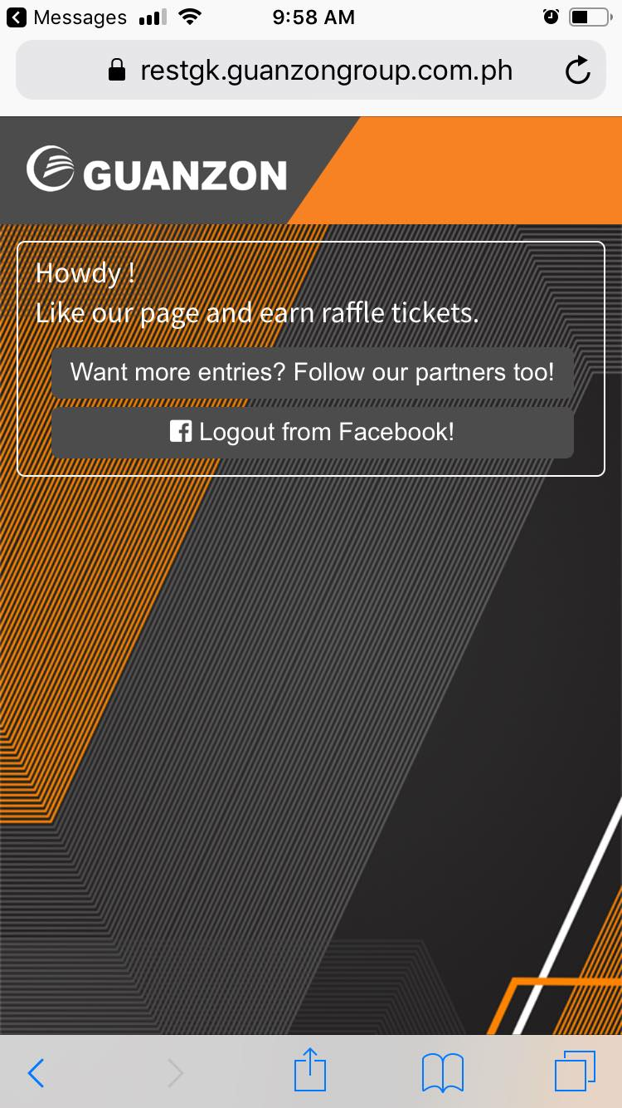
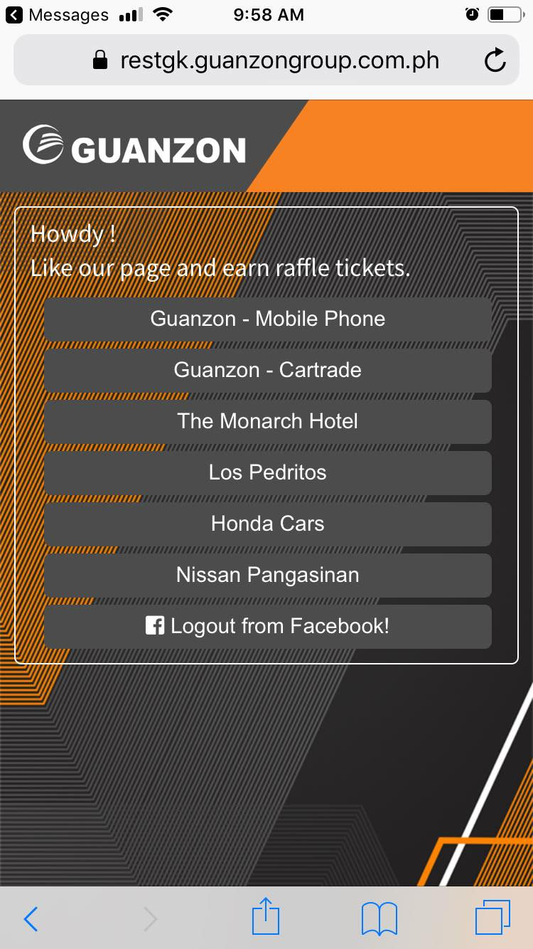
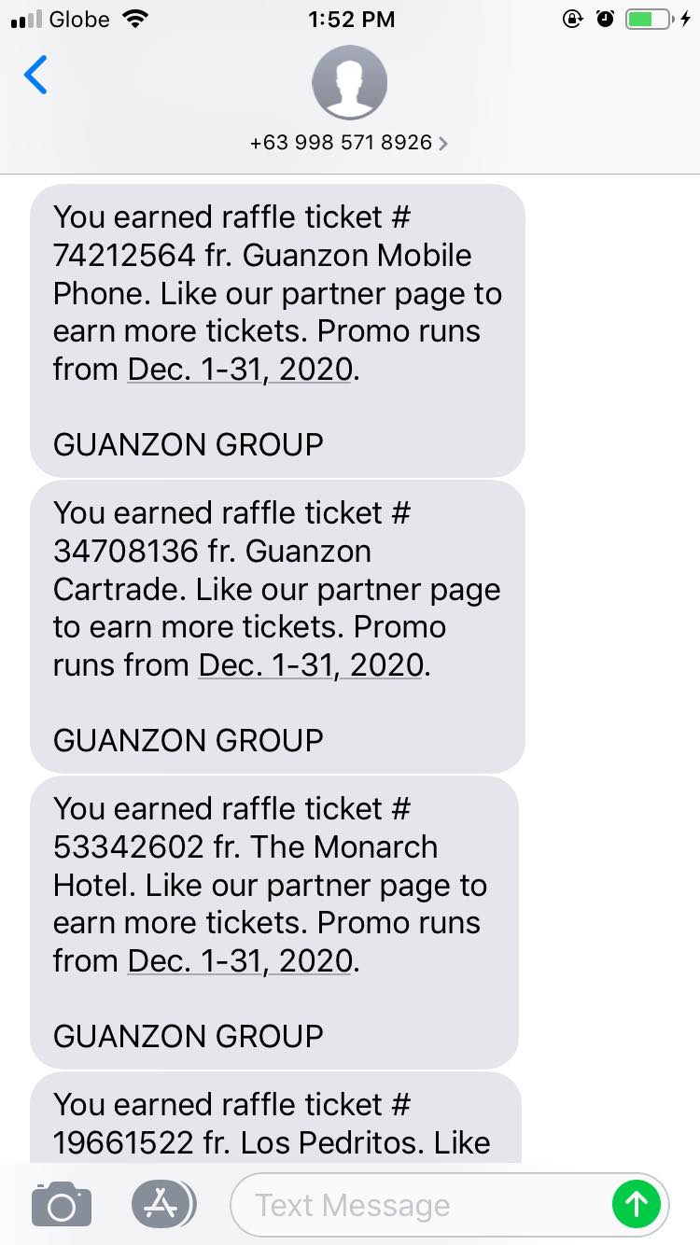
Facebook LIKE Raffle Promo
Facebook Like Raffle Promo Process
The user can earn maximum of 7 raffle tickets by also liking our partners.
The process is still the same from the main company, the user must like the other pages to
earn raffle tickets.
Notes:
Guanzon Group will have a raffle promo wherein clients that transacts to us will earn raffle entries when they LIKED our Facebook page. All transaction with receipts/invoices will have a webpage link and will be sent to the customer’s mobile number. An auto encoder will be installed to the branch’s PCs to auto send the transaction info to our main server, the branch/client shall only wait 1-5 minutes to receive the promo link.

